Slide 1
Cell Organelles
Edited from: Kristen O’Connor

Slide 2
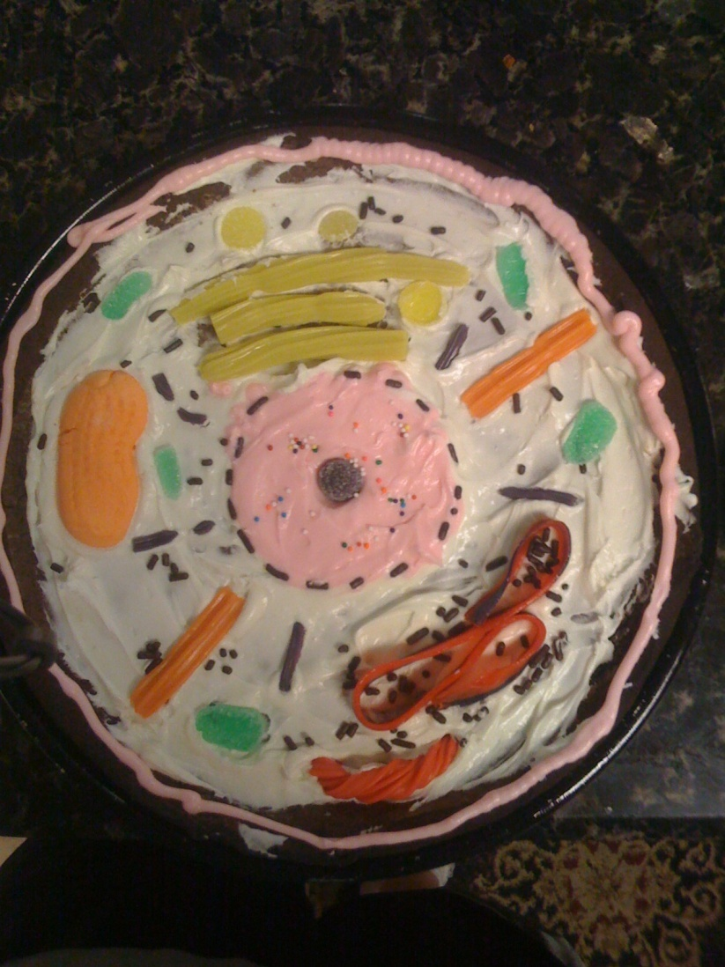
A Taste of What is to Follow... ☺
Ponder This!: How is a cell like a school?

Slide 3
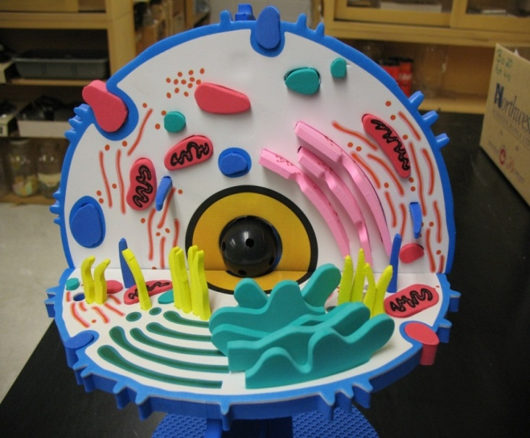
Objectives
Upon completing this lesson you will:
  Know the names of the basic parts, or organelles, of a cell
  Know the functions of all the basic organelles
  Draw or write out your own model or metaphor to demonstrate the parts of a cell

Slide 4
Organization of Living Things
A cell is the basic structural and functional unit of all living things
  Eukaryotic & Prokaryotic
  Animal & Plant
How cells fit into the rest of the body’s organization
Cell
Tissue
Organ
Organ System
Organism

Slide 5
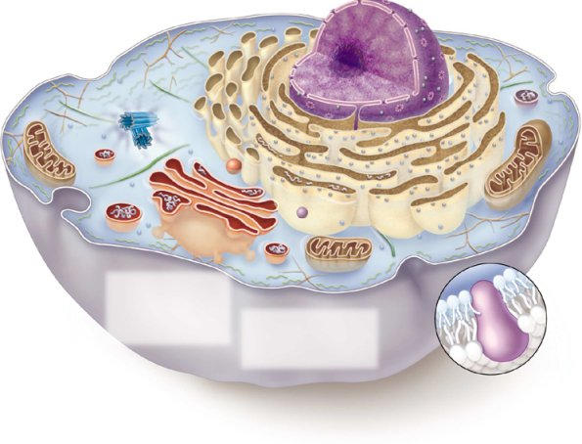
Cell Membrane
Provides support and protection
Functions as cell
Think of our school’s doors and intercom system
and

Slide 6
Cell Wall
ONLY in plant cells
Rigid structure that provides support to a plant
Also found in prokaryotes (bacteria and archea)
Think of the brick walls making up the exterior of the school

Slide 7
Cytoplasm
Jelly-like material that fills the cell–includes the cytoskeleton (proteins that act as muscles and skeleton within the cell)
Contains water and food for cell
Holds organelles in place
Think of the air that fills up this entire school

Slide 8
Nucleus
Contains DNA, which makes you who you are
Directs the activity of the cell – for example, when it grows and d i v i d e s
Think of the principal’s office as the nucleus and the student files in the office as DNA

Slide 9

Endoplasmic Reticulum (E.R.)
The “highway” of the cell that moves materials around to other parts
Some parts of the E.R. contain ribosomes, which create proteins “ribs”
Think of the school hallways where students and teachers transport ideas to other parts of the school
If you drive too fast, you’ll end up in the E.R.!

Slide 10
Golgi Apparatus
(Complex or Body)
Packages, stores, and secretes energy for the cell
Think of the cafeteria workers who bring cafeteria food into the school, then pack and store it in the kitchen for later use

Slide 11
Vesicle
Bubble that forms from the Golgi Complex’s membrane.
It surrounds material to be moved into or out of a cell.
All Eukaryotes have vesicles.
Think of a FedEx truck.

Slide 12
Vacuole
A type of vesicle
Stores digestive enzymes and aids in digestion
Large central vacuole in plant cells stores water and other liquids.
Think of a swimming pool.

Slide 13


Mitochondria
Breaks down food and releases energy to cell – the “Powerhouse” of the cell
Think of lunch time at school – food is taken out of packages, cooked, and then provided to students and teachers to power them for the rest of the day

Slide 14
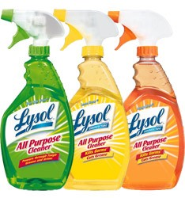
Lysosomes
Vesicles that digest and clean up the cell waste products (Lysosomes clean just like Lysol!)
Think of the custodial workers who clean up any waste in the school at the end of the day

Slide 15
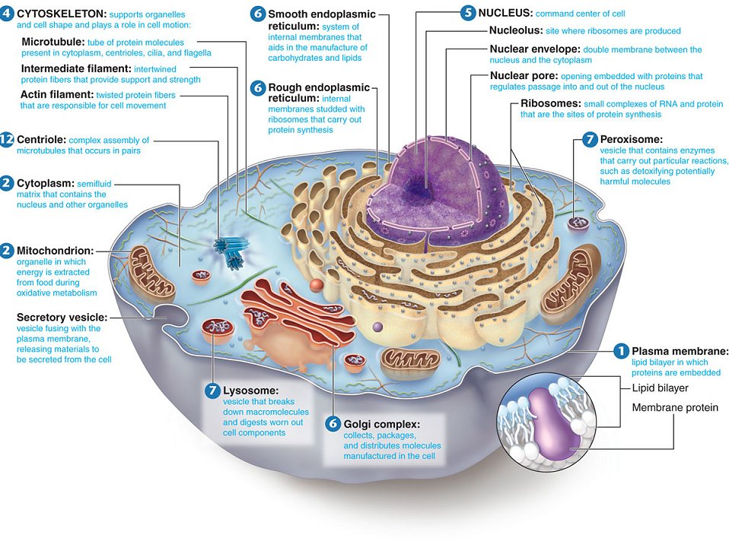

Slide 16

Any questions?

Slide 17
Question One: Did we look at a plant or animal cell today?
A) Plant
B) Animal

Slide 18
Question Two: What is an organelle?
A) The part of the cell that stores, packages, and secretes energy
B) A part of a cell that performs a specific function
C) A small organ inside the body, like one of your kidneys

Slide 19
Question Three: Which organelle is the highway of the cell?
A) Mitochondria
B) Nucleus
C) Endoplasmic Reticulum (E.R.)

Slide 20
Question Four: What is the cell membrane’s function?
A) Allows materials to enter/exit cell
B) Contains the DNA
C) Cleans up cell waste

Slide 21
Question Five: Which organelle is the “powerhouse”?
A) Lysosomes
B) Mitochondria
C) Golgi Apparatus

Slide 22
Question Six: The nucleus contains _____, which makes you who you are genetically
A) Ribosomes
B) Lysosomes
C) DNA

Slide 23
Question Seven: What is the function of the Golgi Apparatus?
A) Packages, stores, and secretes energy
B) Controls basic cell processes
C) Controls what enters/exits cell

Slide 24
Question Eight: What do lysosomes do?
A) Deliver materials to other parts of the cell
B) Clean up cell waste
C) Store food and water

Slide 25
Question Nine: Think hard – which organelle has not been an answer so far? (Hint: it holds the other organelles in place!)
A) Golgi Apparatus
B) Cytoplasm
C) Mitochondria

Slide 26
Question Ten: The drawing of the cell organelles used in this lesson is an example of a :
A) Model
B) Reflective Picture
C) Timeline

Slide 27
Homework
Visit one or both of these interactive cell models online:
  http://learn.genetics.utah.edu/content/begin/cells/insideacell/
  http://www.cellsalive.com/cells/cell_model.htm
Come up with your own cell model or metaphor (either draw/create a picture of a cell or come up with a metaphor that includes the organelles we have studied today)

Slide 28
Image Credits
http://www.praxismh.ca/images/kits/animal%20cell.jpg
http://fc02.deviantart.net/fs36/f/2008/269/c/b/Edible_Cell_Project_by_MoistCake.jpg
http://www.yellowtang.org/images/structure_animal_ce_cu_la_784.jpg
http://www.yellowtang.org/images/structure_animal_ce_c_la_784.jpg
http://www.reliablepaper.com/v/vspfiles/photos/REC75352-2T.jpg

