Slide 1
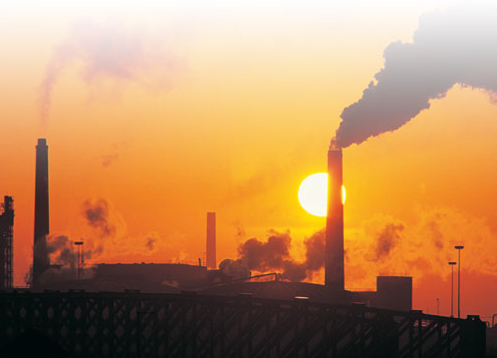
Renewable/Non-renewable Resources
Adapted from UNC-Wilmington curriculum
Notes:
It would be useful to have more teacher notes on each slide

Slide 2
Objectives
List differences between renewable and nonrenewable resources
Make connections between our use of natural resources the availability of those resources

Slide 3
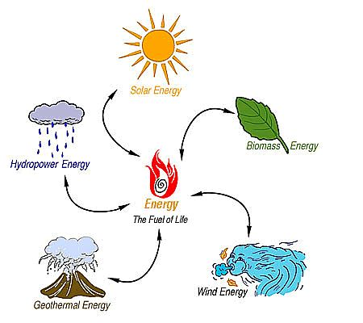
What is a renewable resource?
Renewable resources are natural resources which have an unlimited supply or renew within a few years.
Renewable resources can be used again and again, and will never run out.
Types:
Biomass
Water
Geothermal
Solar
Tidal
Wave
Wind
Wood

Slide 4
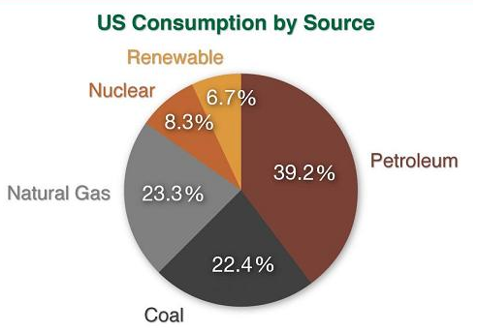
What is a non-renewable resource?
Nonrenewable resources are resources that can’t be replaced or are replaced very slowly (taking 100 years or more to renew).
EXAMPLE: Fossil fuels are continually produced by the decay of plant and animal matter, but the rate of their production is extremely slow, very much slower than the rate at which we use them.
Types:
Coal
Oil (petroleum)
Nuclear
Natural Gas

Slide 5
Follow-Up Questions
Categorize the following as renewable, non-renewable or perpetual resources:
A field of corn
Oil in the Arctic tundra
Coal in the Appalachian mountains
Sunshine
Trees in a forest
Tuna in the ocean
Sand on a beach
A breeze over the Texas plains
Water in a river
Which resources would continue to be available no matter how much people used them?
Under what circumstances would a renewable resource not be renewable?
Notes:
Have we defined perpetual resources? I don’t even know how to classify Sand on a beach – if you’re a glassmaker it’s a nonrenewable source, isn’t it?

Slide 6
Follow-Up Questions
What could be some effects of population growth, natural disasters, disease, and advanced technology systems on resource availability?
What are some advantages and disadvantages of using renewable resources in place of non-renewable resources?
List as many renewable resources as you can find in your classroom.
List as many non-renewable resources as you can that are found in your classroom.
Notes:
Provide examples here (and explanations in the case that the examples might be subjective) of answers to each question

