Slide 1
Renewable Energy Technology Resource Maps and Technical Potential for the United States
Updated July 2012

Slide 2
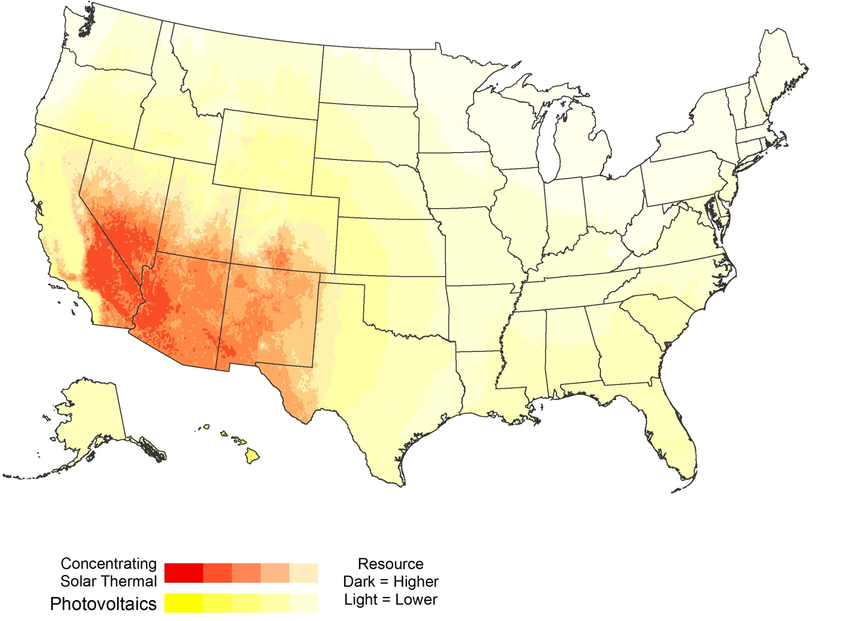
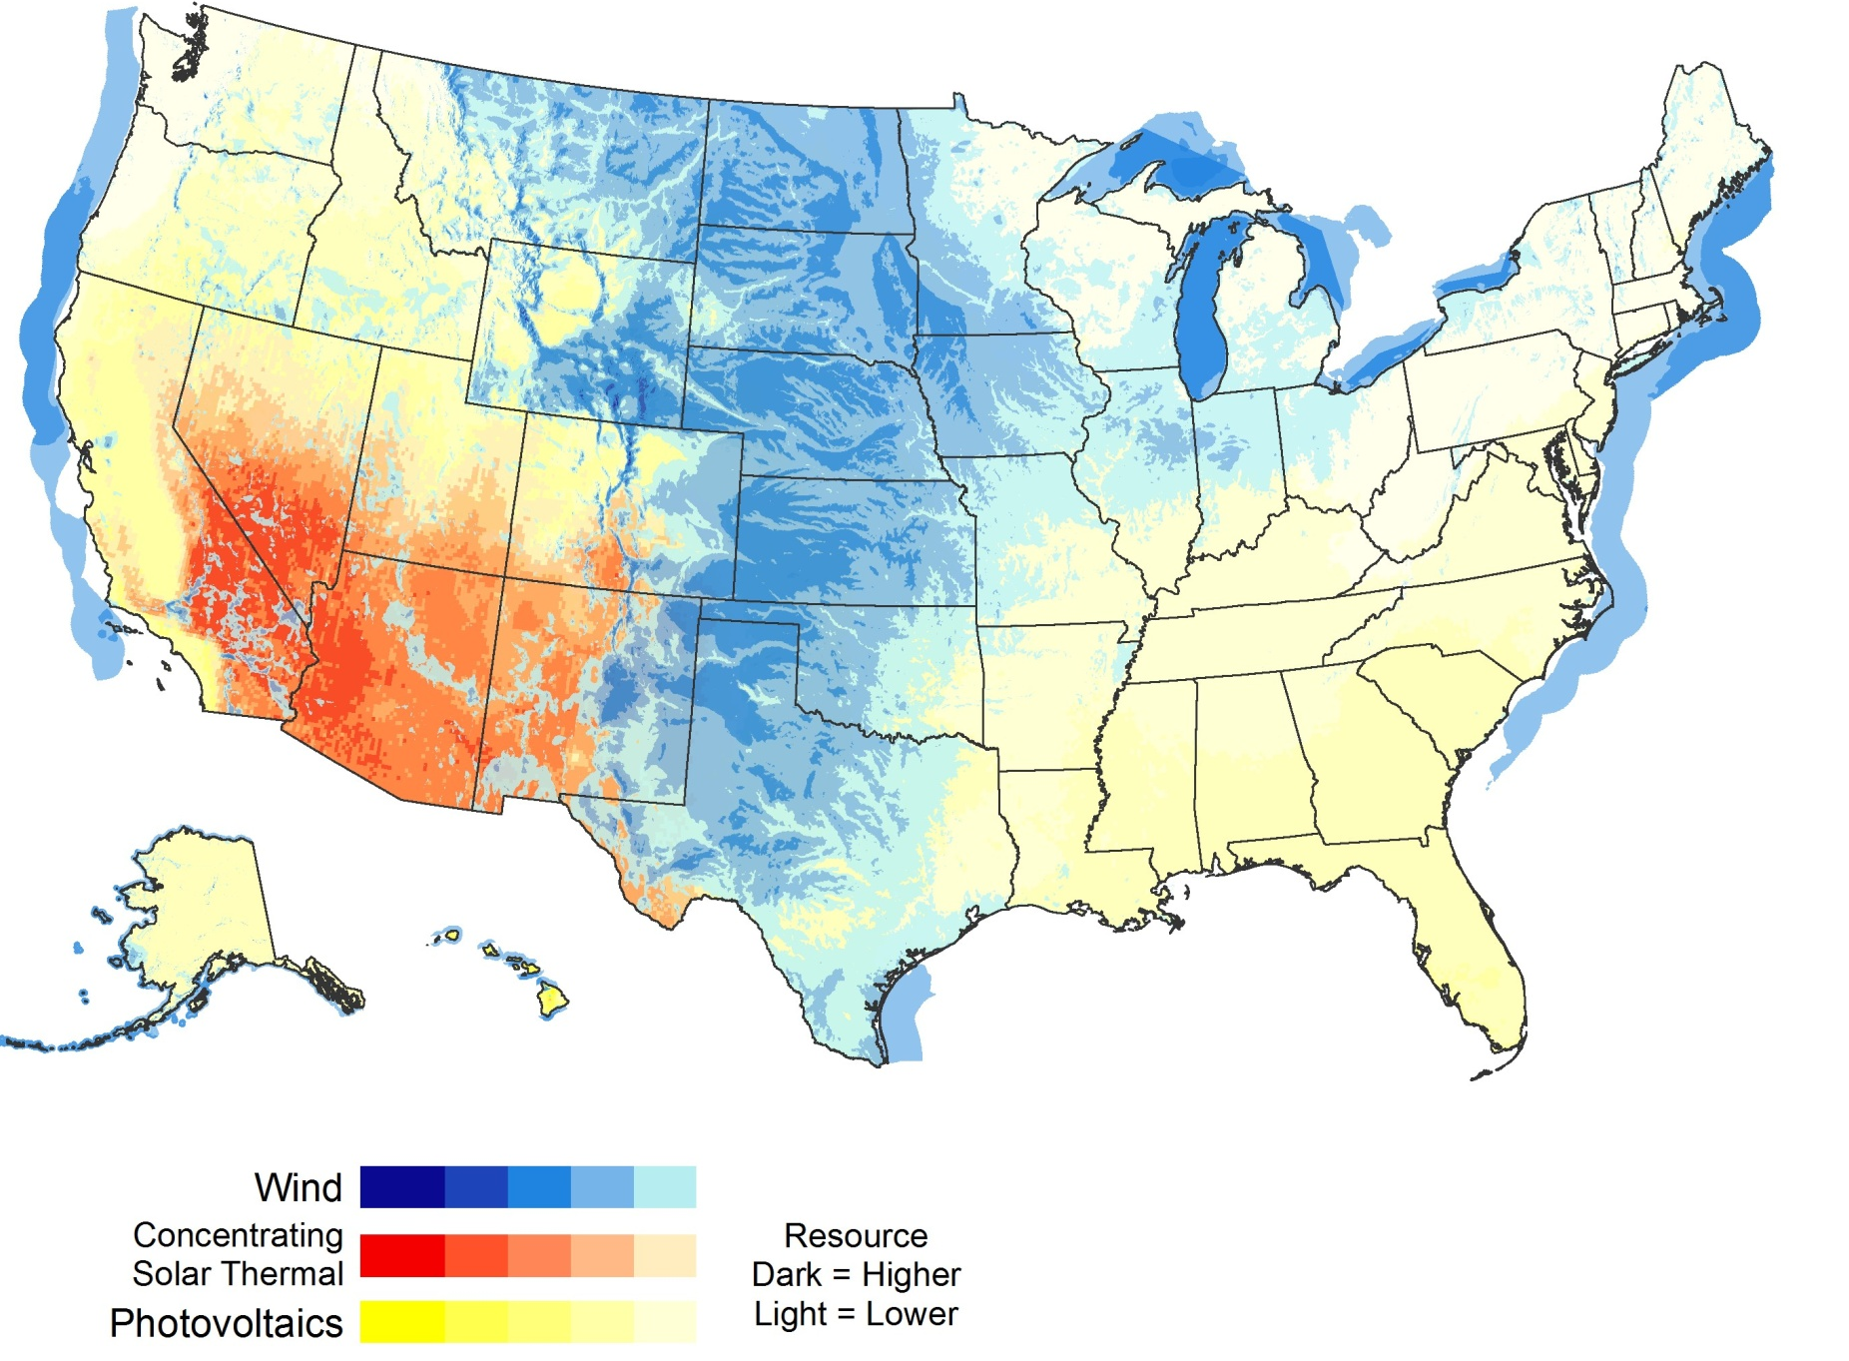
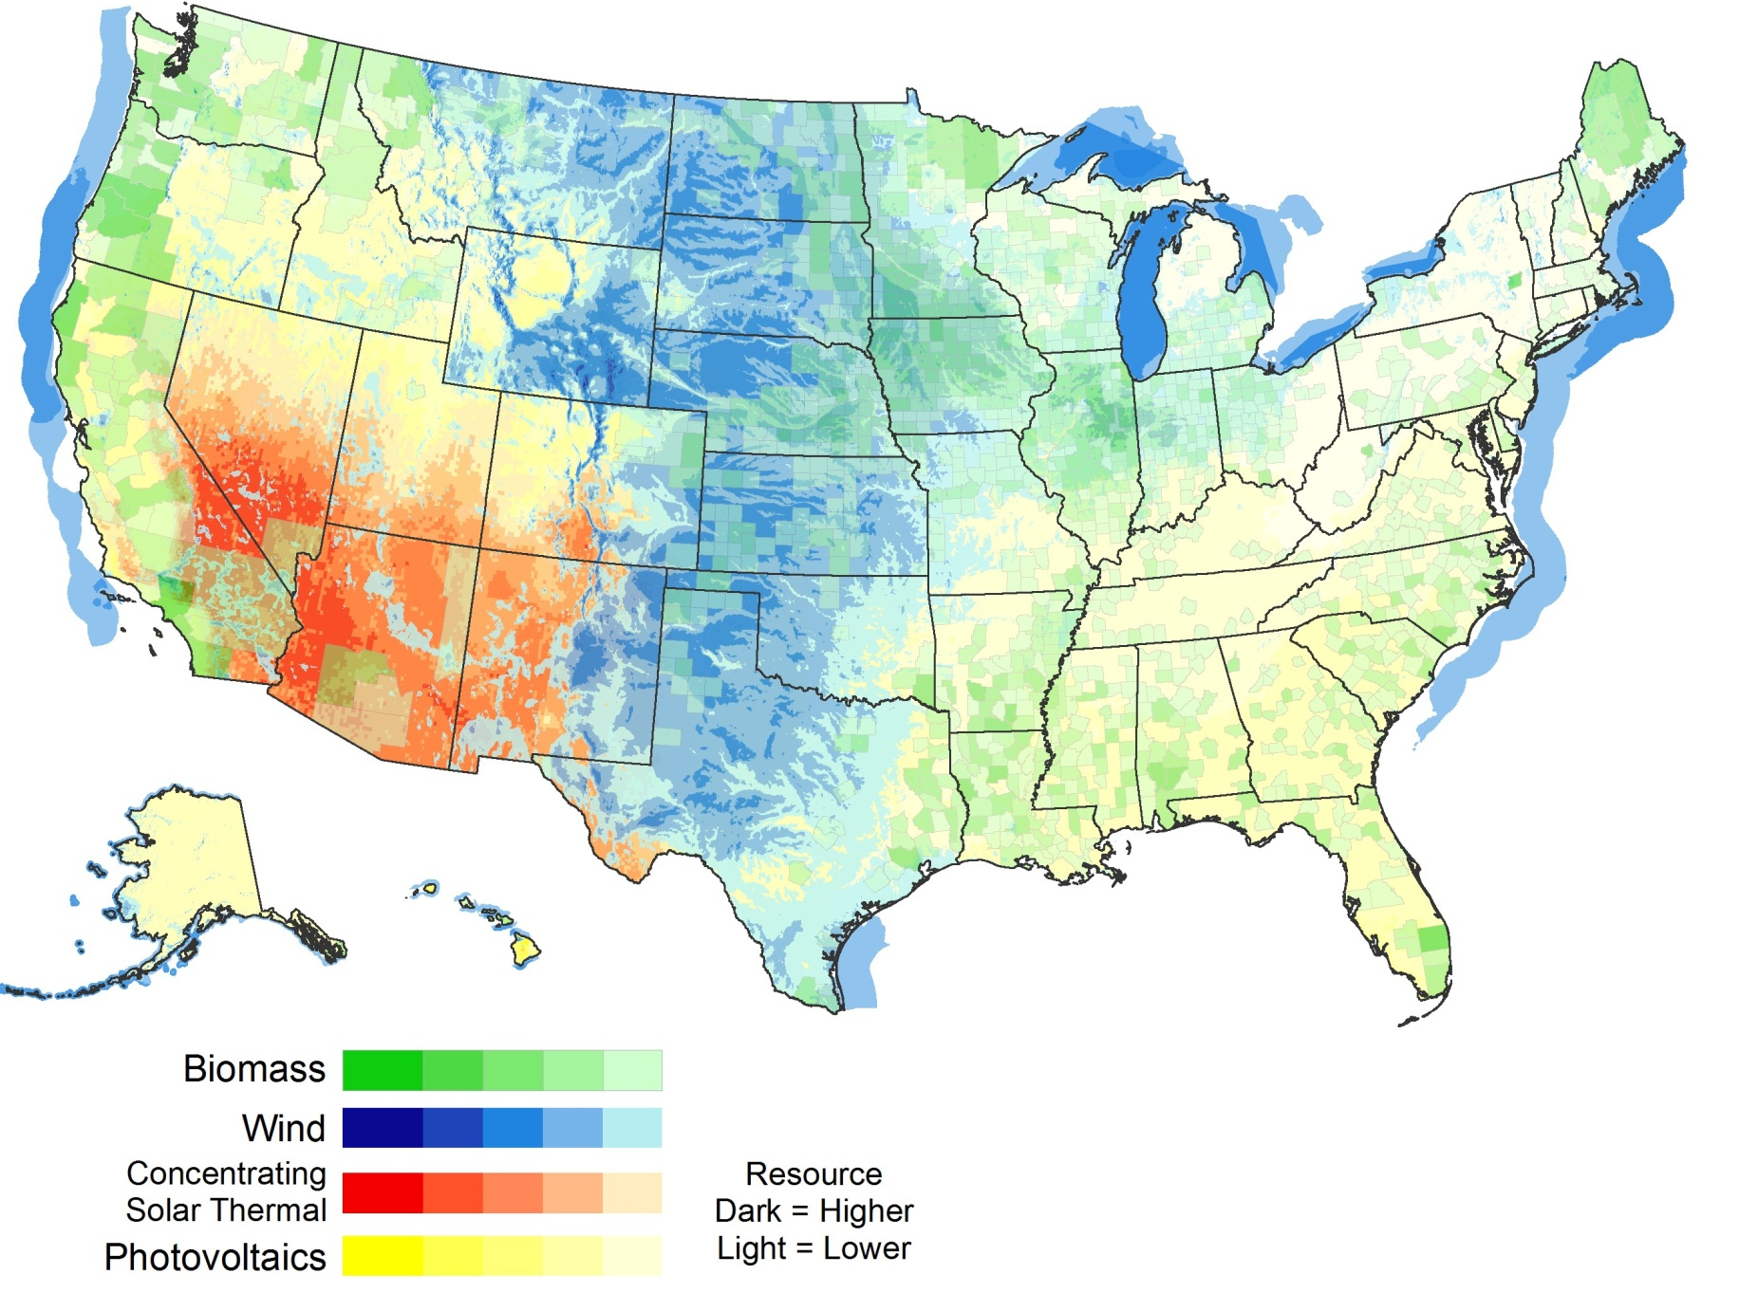
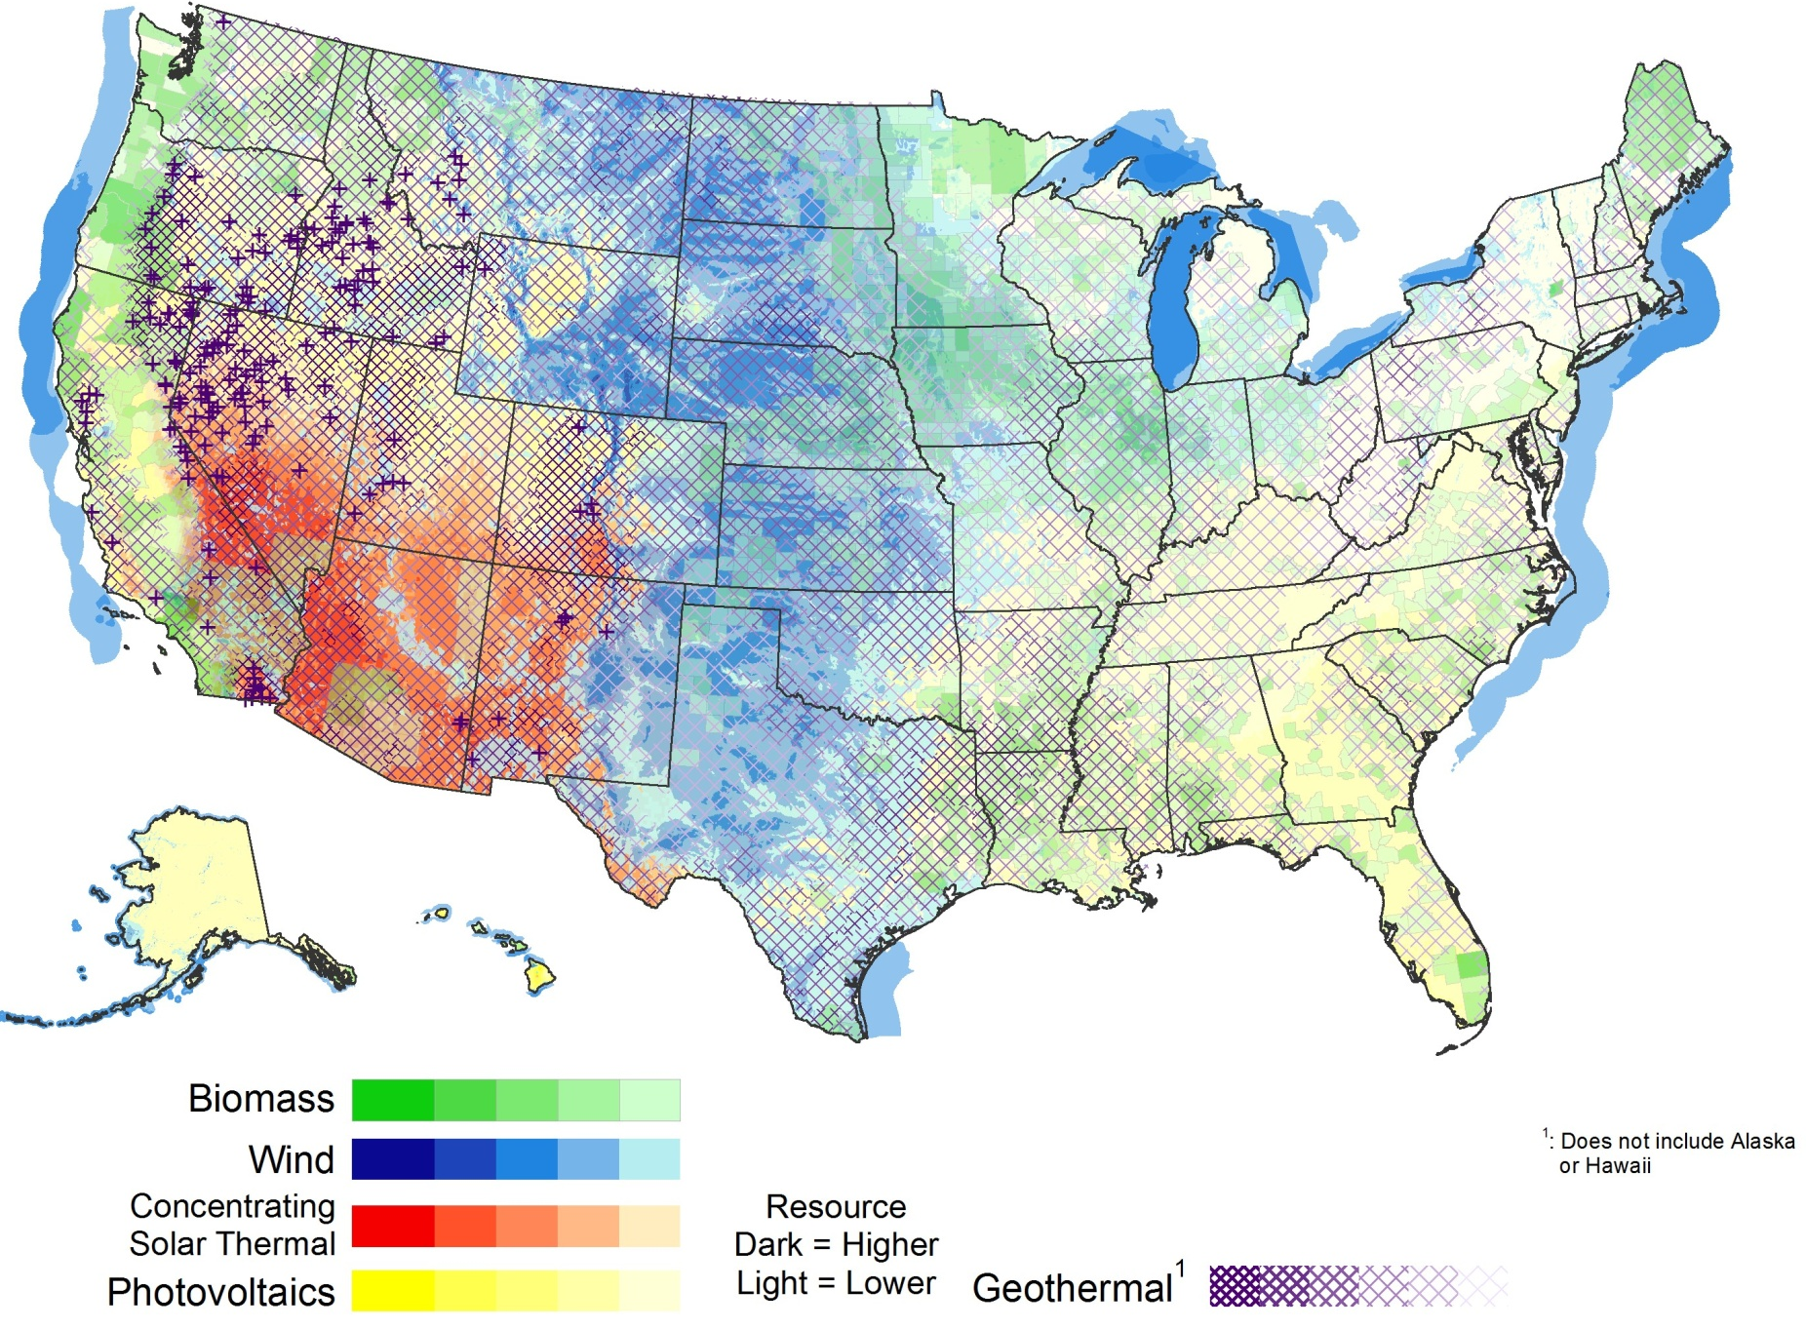
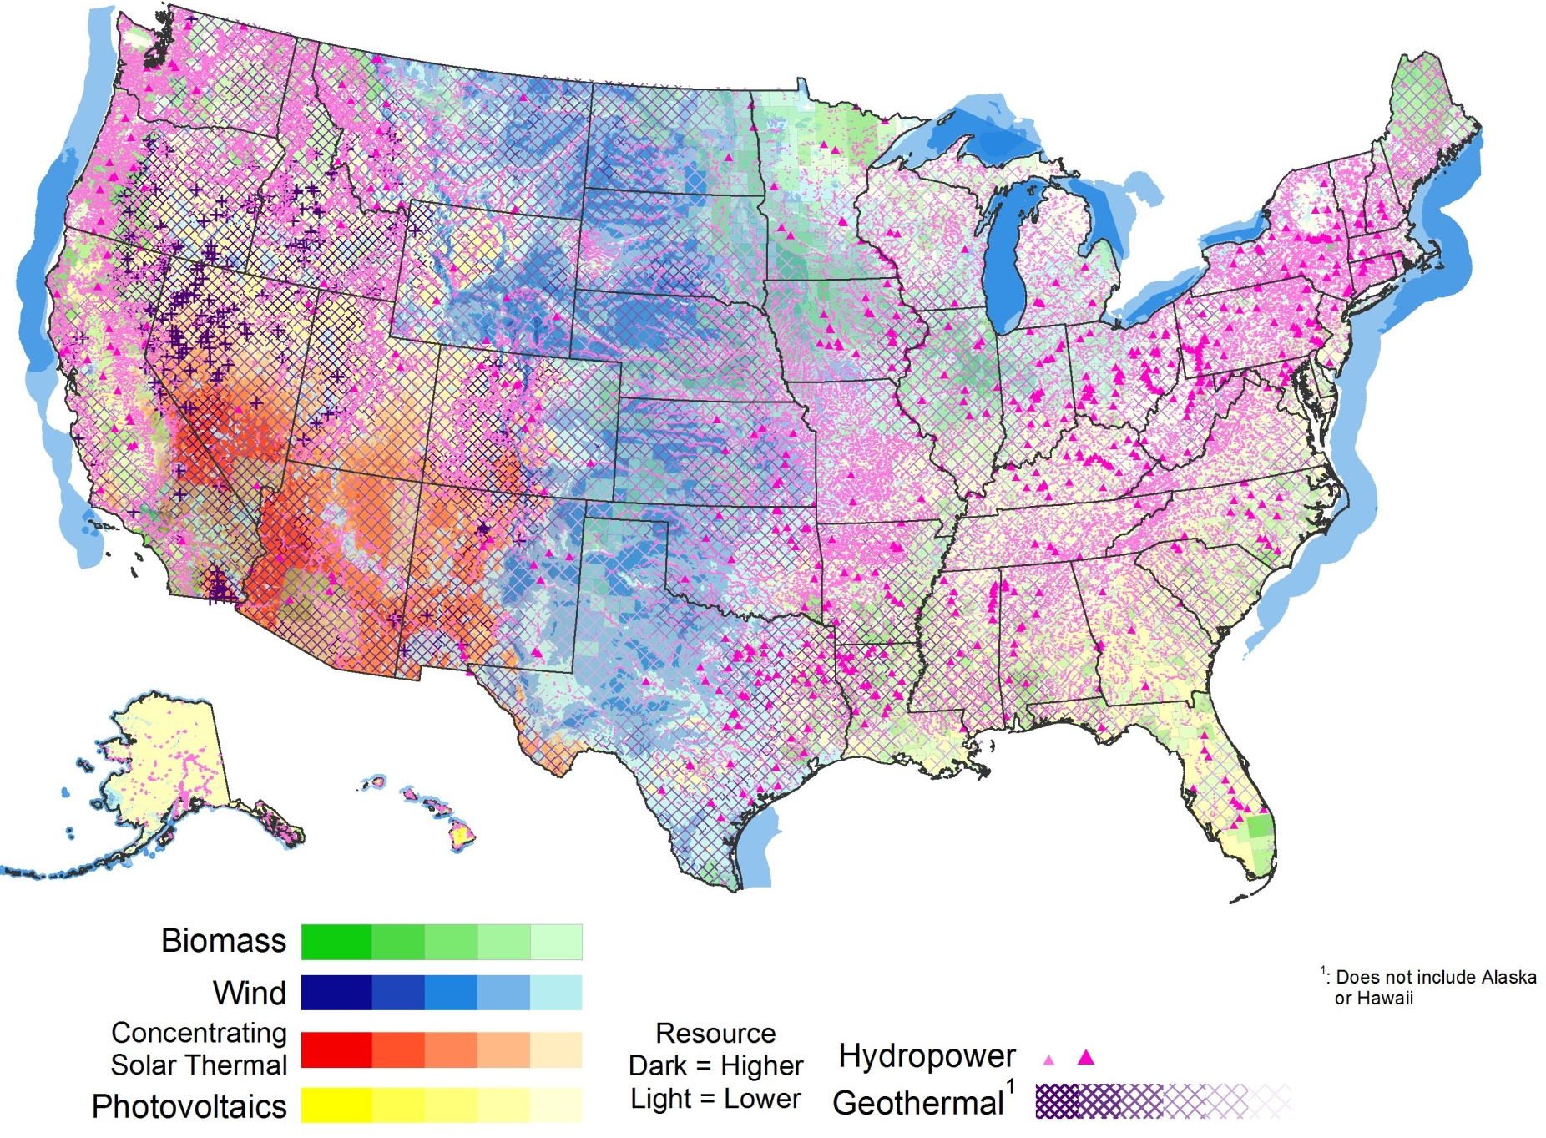
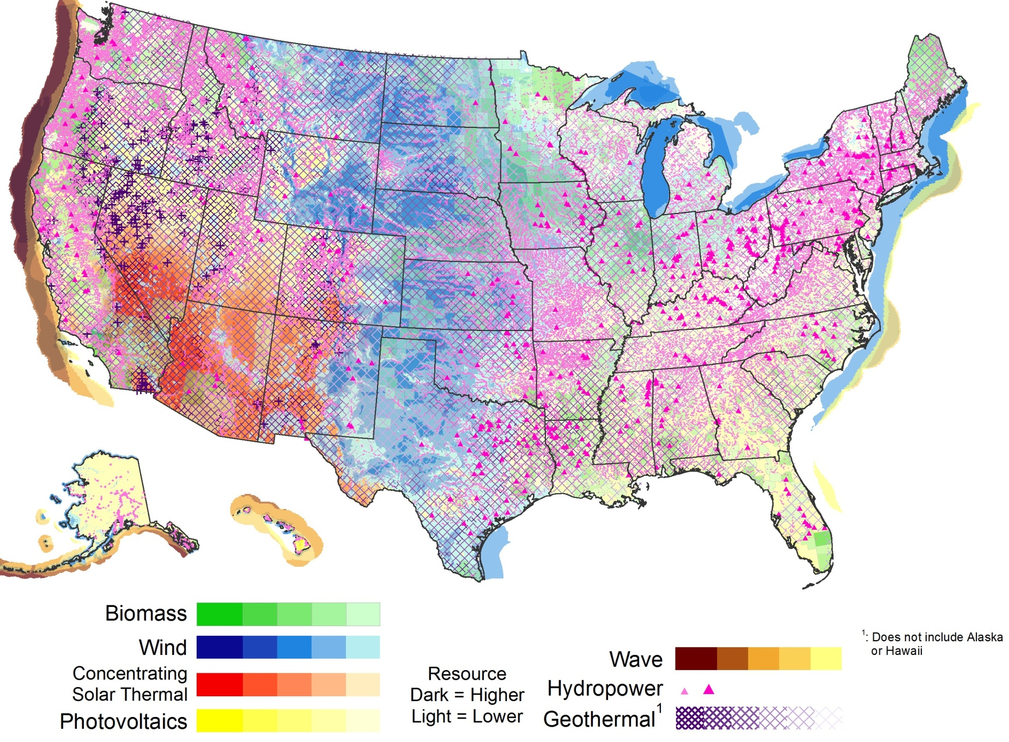
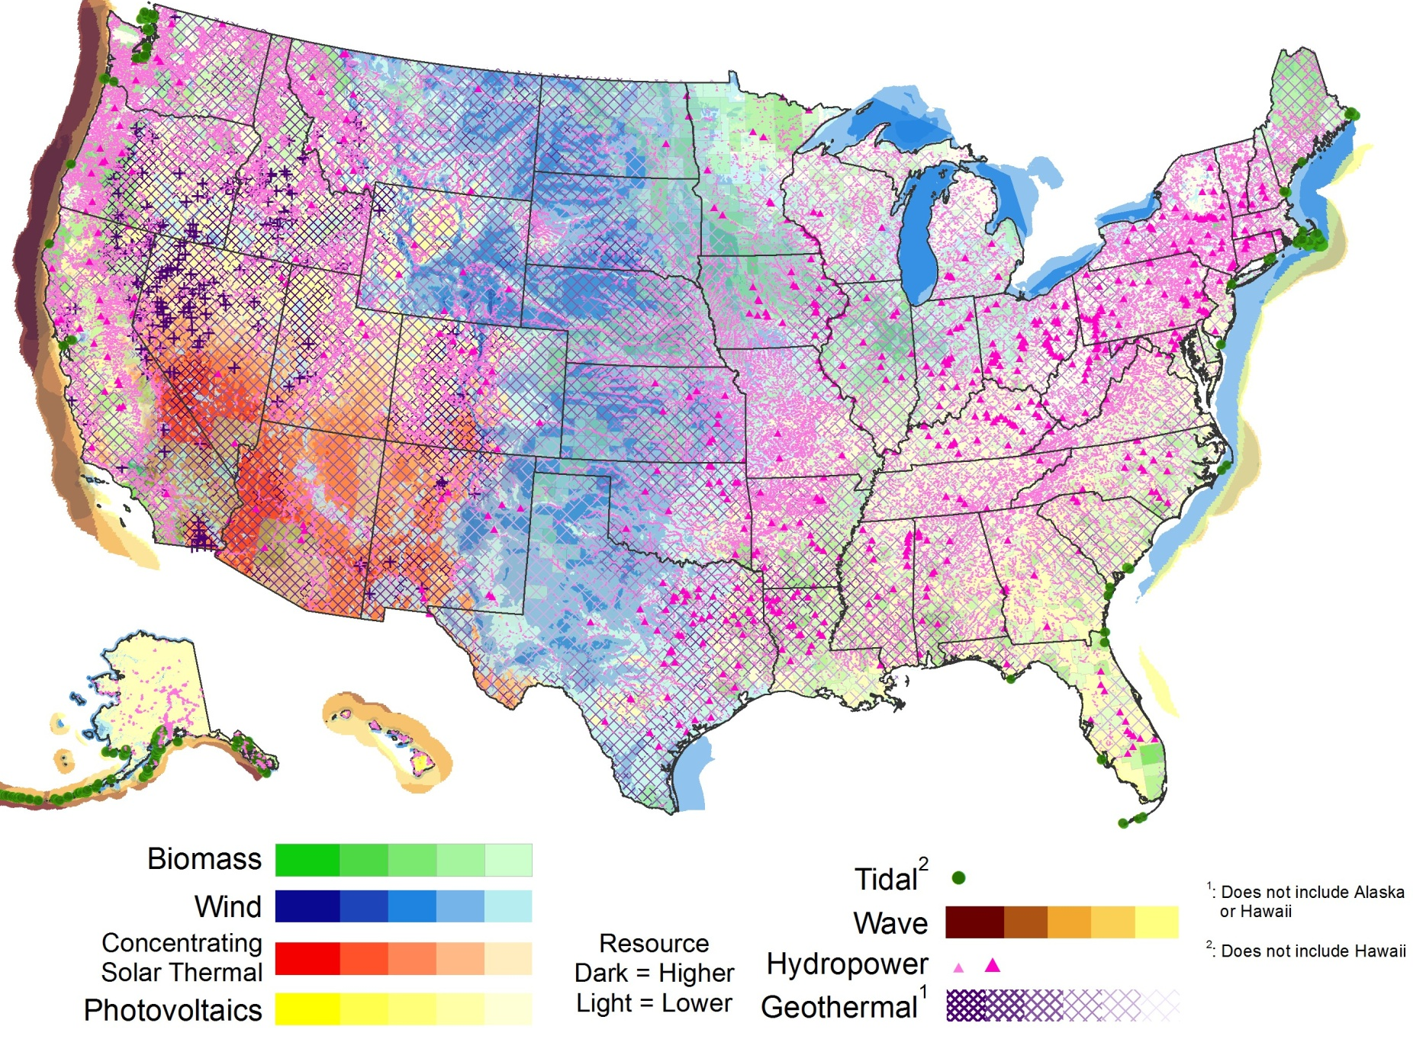
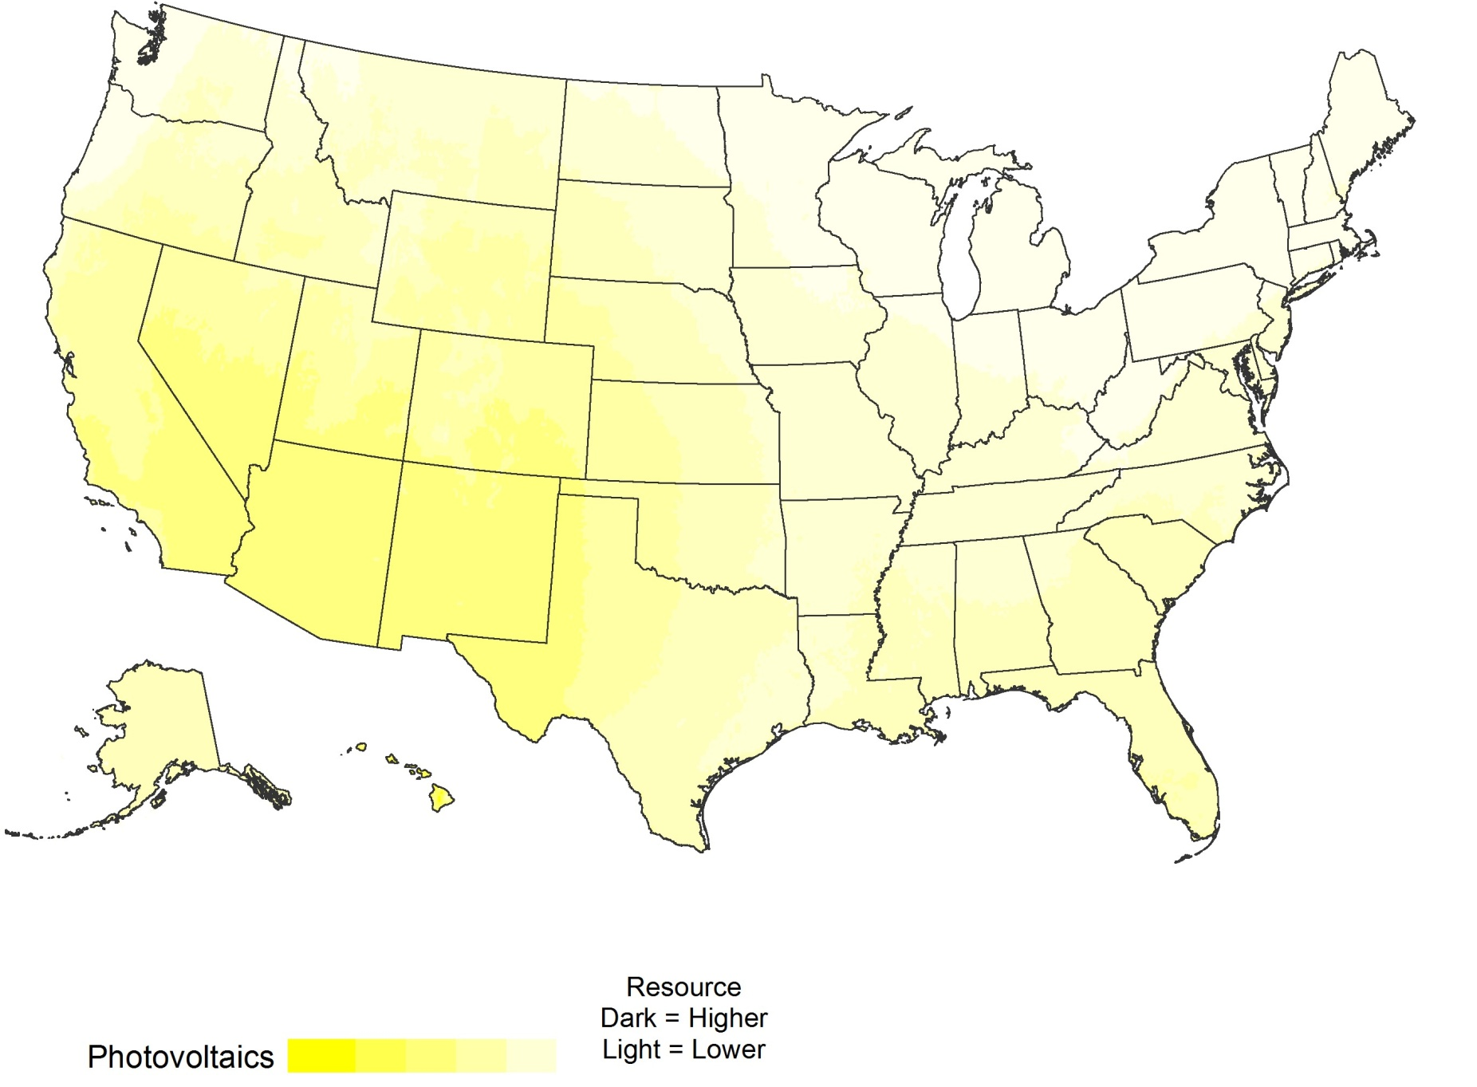
U.S. Renewable Resources
Resource | Solar PV/CSP) | Wind | Geothermal | Water Power | Biopower
Theoretical Potential | 155,000 GW (PV) 38,000GW (CSP) | 11,000 GW (onshore) 4,200 GW (offshore to 50 nm) | 38 GW (conventional) 4,000 GW (EGS) | 68 GW | 62 GW
Technical potential
sources and
assumptions are
listed in the slide
notes.
Notes:
1) Technical potential estimates for solar, wind, geothermal, hydropower, and biopower were extracted from NREL’s report U.S. Renewable Energy Technical Potentials: A GIS-Based Analysis (2012). However, the hydropower potential was augmented as noted below in (5).
2) Solar: Estimates of potentials for both PV and CSP are assumed to be unconstrained by grid limitations such as lack of storage or transmission capacity. For PV, the solar resource potential is separated into utility scale PV in urban and rural areas, and rooftop PV potential.
Utility scale PV in urban areas was restricted to large urban open spaces with slope <= 3% and a minimum of 18,000 m² (large enough to support ~1 MW of PV). Installed capacity for utility scale PV assumes an installation density of 48 MW/km².
Utility scale PV in rural areas was restricted by excluding federal protected lands, water features and wetlands, and allowing installations only where land surface slopes are <= 3%. Resulting areas must be >= 1 km² to be included in the technical potential calculation. Installed capacity for utility scale PV assumes an installation density of 48 MW/km².
Rooftop PV potentials were estimated by Denholm and Margolis (2008, “Supply Curves for rooftop Solar PV-Generated electricity for the United States”) using commercial and residential building estimates of rooftop availability % for buildings in different climates, and assumes an installation density of 100 W/m² for flat roofs and 135 W/m² for other roofs.
The CSP potential calculations use the same land filters used for utility scale PV in rural areas, but is also restricted based on direct normal solar insolation values to areas with an average annual value of 5.0 kWh/m²/day. Installed capacity for CSP assumes an installation density of 32.8 MW/km², for a trough system with six hours of storage and a solar multiple of 2.
3) Wind: Onshore wind potential at 80 m ht above surface was modified from the analysis conducted by NREL and AWST (http://www.windpoweringamerica.gov/windmaps/resource_potential.asp), limiting resource areas to those with annual gross capacity factor of 30% or more for typical utility scale wind turbines. Urban areas, protected lands, and onshore water features are excluded, and land availability is reduced in non-ridgecrest forest areas. Offshore wind potential was estimated using 90 m height annual average wind speed data as described in Assessment of Offshore Wind Energy Resources for the United States (Schwartz et. al, 2010), with exclusions to eliminate marine sanctuaries, shipping lanes, and within 50 nautical miles of the U.S. coastline. Installation density for both onshore and offshore wind is estimated assuming 5 MW/km2.
4) Geothermal: Hydrothermal potential (identified and undiscovered) is taken from the USGS reports “Assessment of Moderate- and High-Temperature Geothermal Resources of the United States” (2008, Williams et al.) and “Quantifying the Undiscovered Geothermal Resources of the United States” (2009, Williams et al.). Enhanced Geothermal Systems (EGS) potential was derived from an analysis of temperature at depths ranging from 3 km to 10km, produced by Southern Methodist University Laboratory. High temperature areas are most favorable for early development using Enhanced Geothermal System (EGS) technology, while low temperature areas are possible resources in future. Individual areas identified by a dark + symbol indicate high temperature anomalies where identified conventional hydrothermal resources are located.
5) Long-term hydroelectric potential is drawn from a GIS-based study by INL: Feasibility Assessment of the Water Energy Resources of the United States for New Low Power and Small Hydro Classes of Hydroelectric Plants, January 2006. Non-powered dams from the National Hydropower Asset Assessment Program are also shown, and the estimated 8 GW of potential added to the 60 GW of estimated potential from the INL report.
6) Biopower potential estimated based on available residue data from the NREL report Geographic Perspective on the Current Biomass Resource Availability in the United States (Milbrandt, 2004), with some data updates in 2008. The potential calculation assumes 1.1 MWh/bone dry tonne, higher heating values of 8,500 BTU/lb, and a conversion efficiency of 20% for solid residues; 4.7 MWh/tonne of CH₄, higher heating value of 34,250 BTU/lb, and 30% conversion efficiency for gaseous residues.

Slide 3
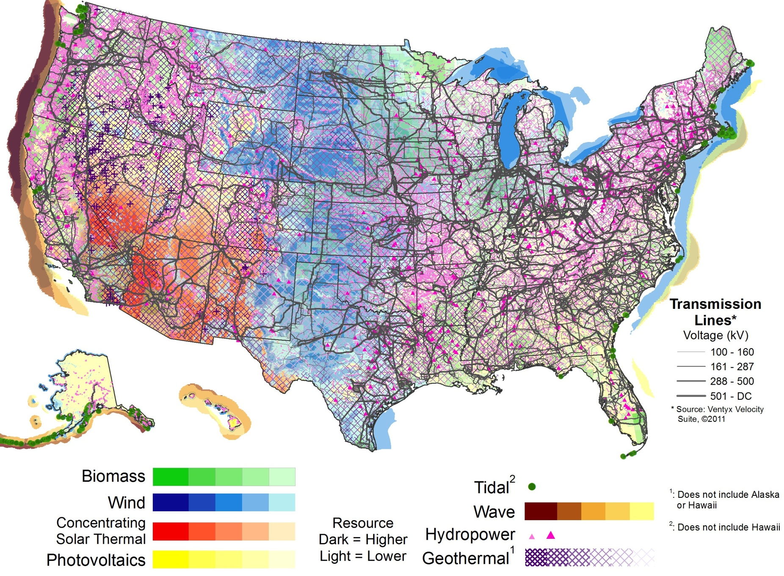
U.S. Renewable Resources
Resource | Solar PV/CSP) | Wind | Geothermal | Water Power | Biopower
Theoretical Potential | 155,000 GW (PV) 38,000GW (CSP) | 11,000 GW (onshore) 4,200 GW (offshore to 50 nm) | 38 GW (conventional) 4,000 GW (EGS) | 68 GW | 62 GW
Technical potential
sources and
assumptions are
listed in the slide
notes.
Notes:
1) Technical potential estimates for solar, wind, geothermal, hydropower, and biopower were extracted from NREL’s report U.S. Renewable Energy Technical Potentials: A GIS-Based Analysis (2012). However, the hydropower potential was augmented as noted below in (5).
2) Solar: Estimates of potentials for both PV and CSP are assumed to be unconstrained by grid limitations such as lack of storage or transmission capacity. For PV, the solar resource potential is separated into utility scale PV in urban and rural areas, and rooftop PV potential.
Utility scale PV in urban areas was restricted to large urban open spaces with slope <= 3% and a minimum of 18,000 m² (large enough to support ~1 MW of PV). Installed capacity for utility scale PV assumes an installation density of 48 MW/km².
Utility scale PV in rural areas was restricted by excluding federal protected lands, water features and wetlands, and allowing installations only where land surface slopes are <= 3%. Resulting areas must be >= 1 km² to be included in the technical potential calculation. Installed capacity for utility scale PV assumes an installation density of 48 MW/km².
Rooftop PV potentials were estimated by Denholm and Margolis (2008, “Supply Curves for rooftop Solar PV-Generated electricity for the United States”) using commercial and residential building estimates of rooftop availability % for buildings in different climates, and assumes an installation density of 100 W/m² for flat roofs and 135 W/m² for other roofs.
The CSP potential calculations use the same land filters used for utility scale PV in rural areas, but is also restricted based on direct normal solar insolation values to areas with an average annual value of 5.0 kWh/m²/day. Installed capacity for CSP assumes an installation density of 32.8 MW/km², for a trough system with six hours of storage and a solar multiple of 2.
3) Wind: Onshore wind potential at 80 m ht above surface was modified from the analysis conducted by NREL and AWST (http://www.windpoweringamerica.gov/windmaps/resource_potential.asp), limiting resource areas to those with annual gross capacity factor of 30% or more for typical utility scale wind turbines. Urban areas, protected lands, and onshore water features are excluded, and land availability is reduced in non-ridgecrest forest areas. Offshore wind potential was estimated using 90 m height annual average wind speed data as described in Assessment of Offshore Wind Energy Resources for the United States (Schwartz et. al, 2010), with exclusions to eliminate marine sanctuaries, shipping lanes, and within 50 nautical miles of the U.S. coastline. Installation density for both onshore and offshore wind is estimated assuming 5 MW/km2.
4) Geothermal: Hydrothermal potential (identified and undiscovered) is taken from the USGS reports “Assessment of Moderate- and High-Temperature Geothermal Resources of the United States” (2008, Williams et al.) and “Quantifying the Undiscovered Geothermal Resources of the United States” (2009, Williams et al.). Enhanced Geothermal Systems (EGS) potential was derived from an analysis of temperature at depths ranging from 3 km to 10km, produced by Southern Methodist University Laboratory. High temperature areas are most favorable for early development using Enhanced Geothermal System (EGS) technology, while low temperature areas are possible resources in future. Individual areas identified by a dark + symbol indicate high temperature anomalies where identified conventional hydrothermal resources are located.
5) Long-term hydroelectric potential is drawn from a GIS-based study by INL: Feasibility Assessment of the Water Energy Resources of the United States for New Low Power and Small Hydro Classes of Hydroelectric Plants, January 2006. Non-powered dams from the National Hydropower Asset Assessment Program are also shown, and the estimated 8 GW of potential added to the 60 GW of estimated potential from the INL report.
6) Biopower potential estimated based on available residue data from the NREL report Geographic Perspective on the Current Biomass Resource Availability in the United States (Milbrandt, 2004), with some data updates in 2008. The potential calculation assumes 1.1 MWh/bone dry tonne, higher heating values of 8,500 BTU/lb, and a conversion efficiency of 20% for solid residues; 4.7 MWh/tonne of CH₄, higher heating value of 34,250 BTU/lb, and 30% conversion efficiency for gaseous residues.

Slide 4
U.S. Photovoltaic Solar Resource

Slide 5
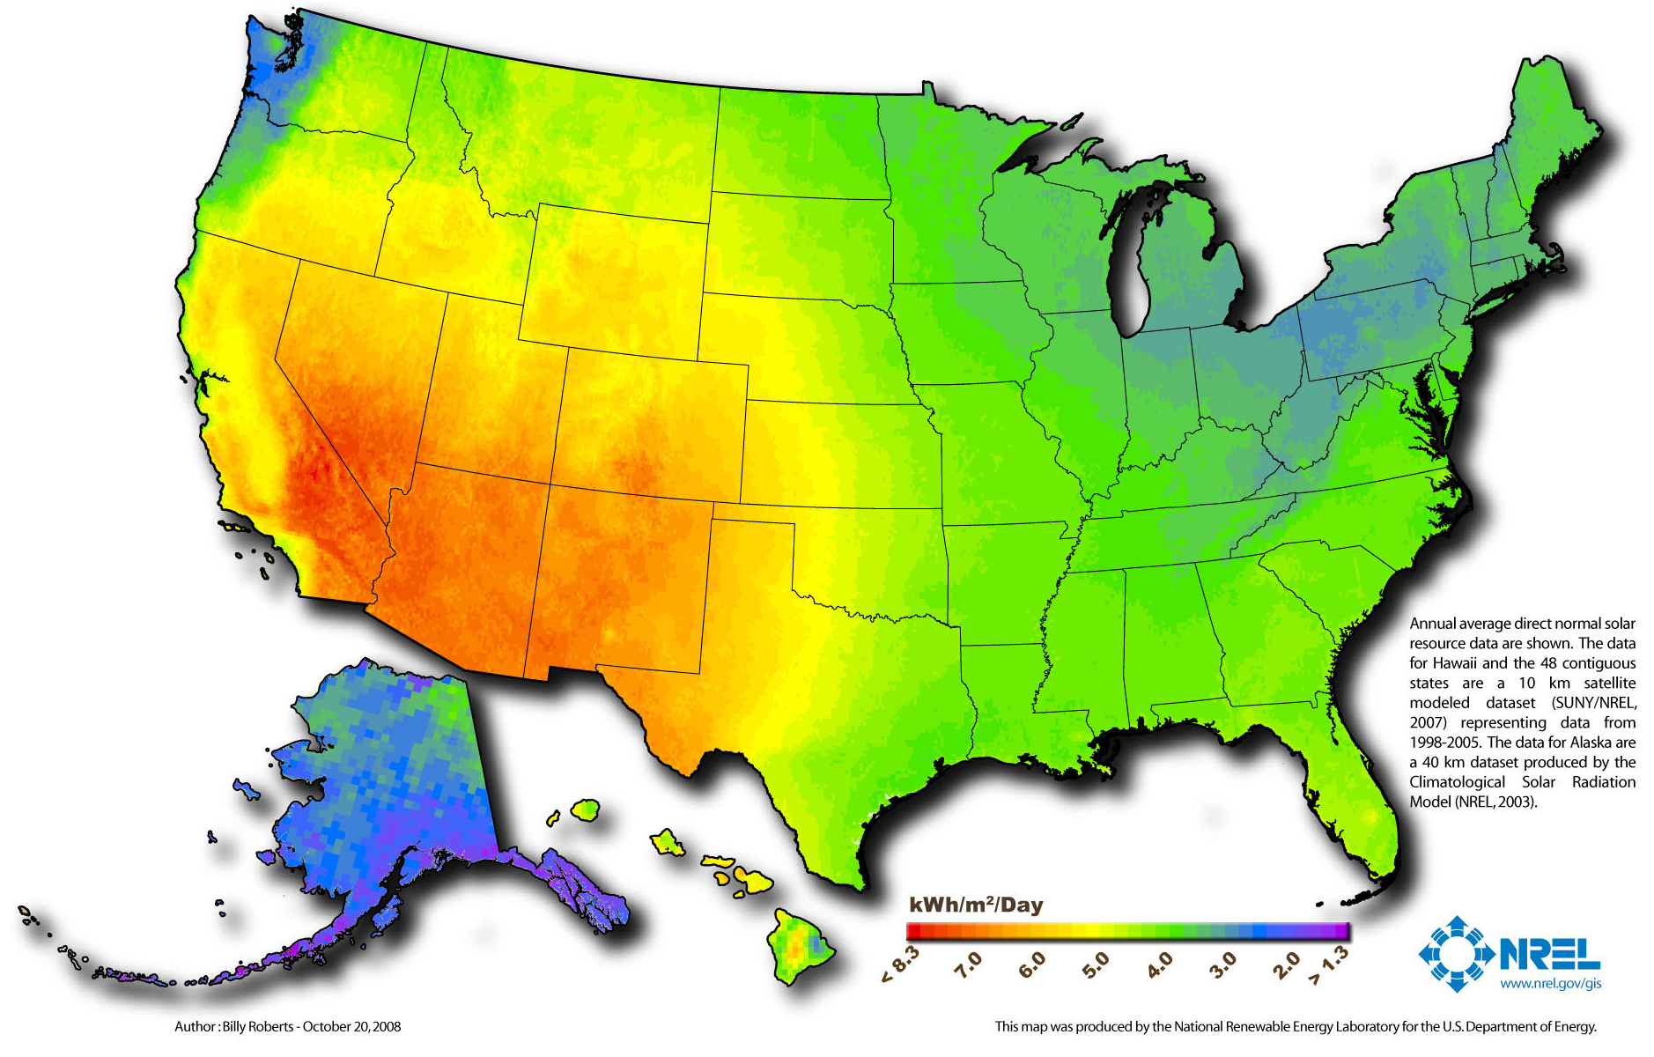
U.S. Concentrating Solar Resource

Slide 6
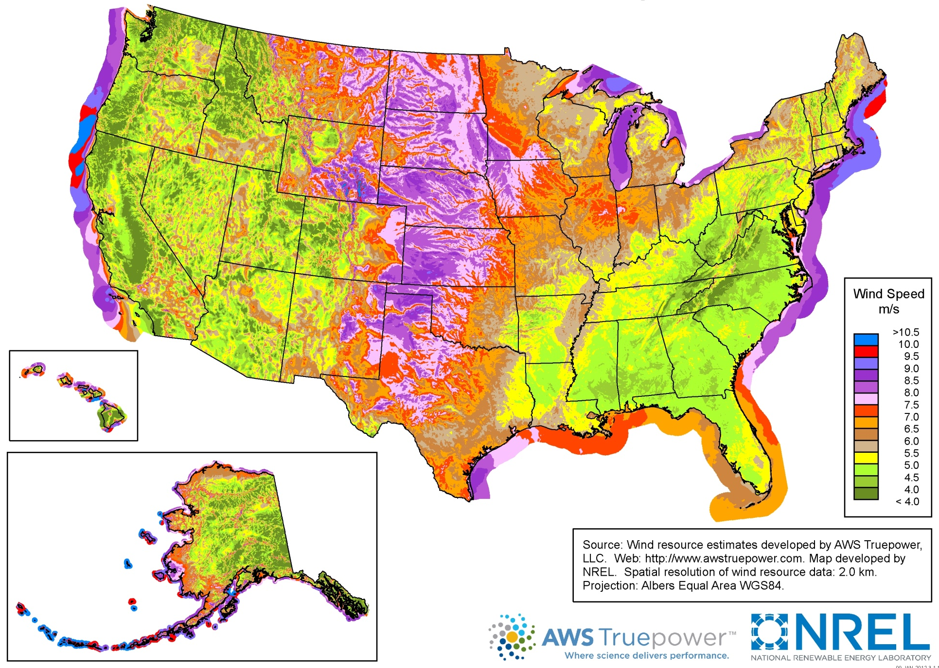
U.S. Wind Resource (80m)

Slide 7
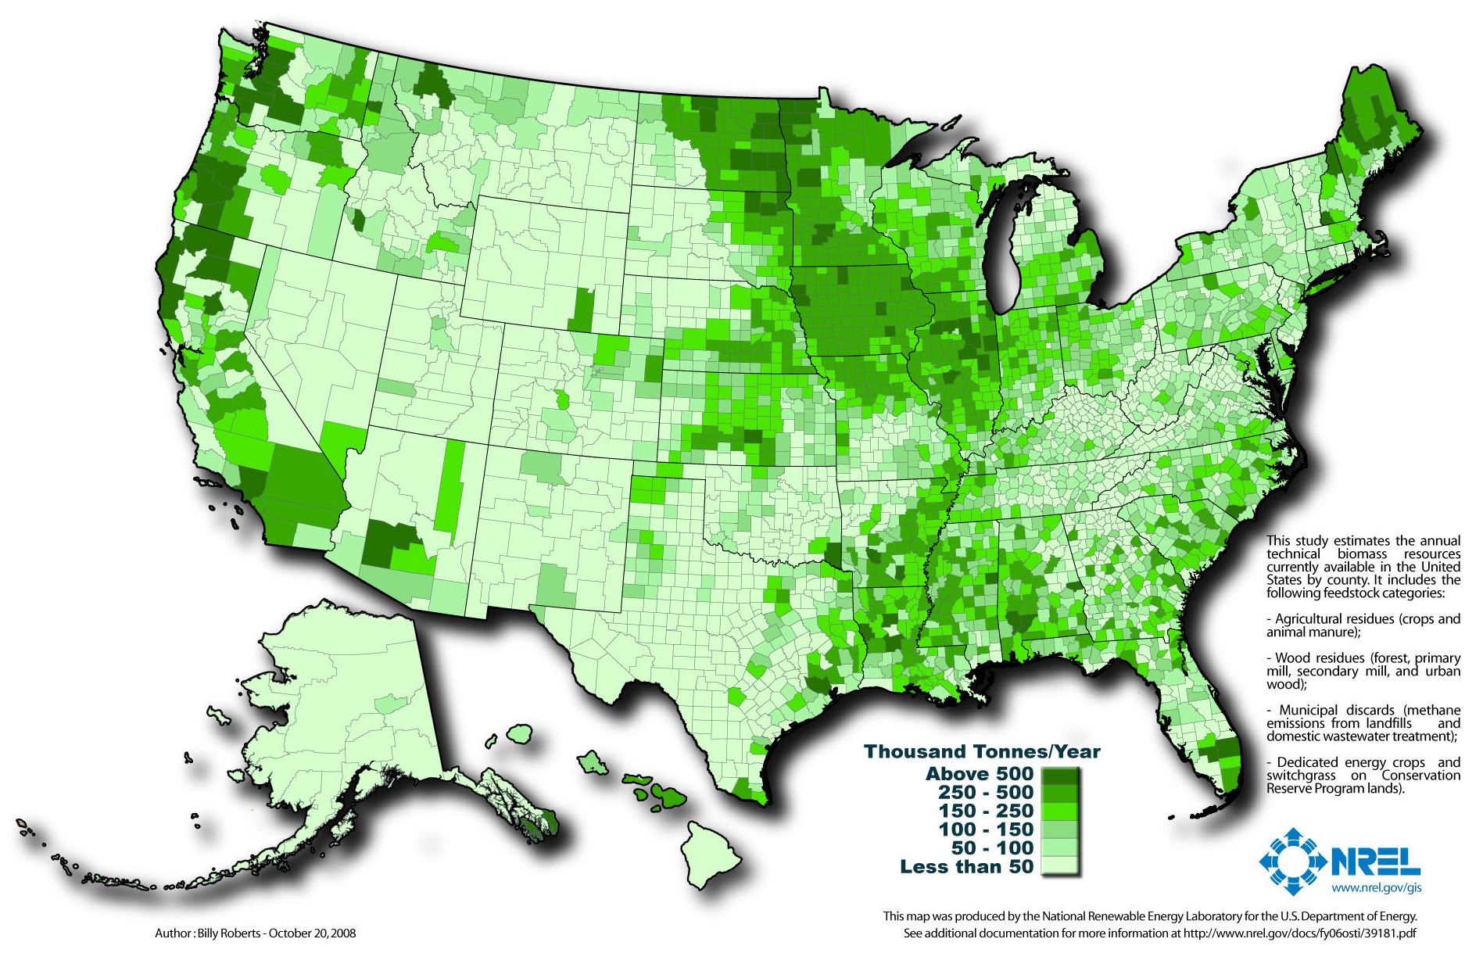
U.S. Biomass Resource

Slide 8
